Slide 1
Calibration and validation for space-based optical sensors
Hirokazu YAMAMOTO (ITRI/AIST)
Sarawut NINSAWAT (AIT)
Takahisa MAEDA (EMTech/AIST)

Slide 2
Outline
Introduction
Optical satellite sensors
Background
On-board calibration, vicarious calibration, and cross-calibration
Validation for radiometric and atmospheric corrections for surface reflectances, VIs, and GPP/NPP satellite-derived products
Ground measurement for GPP
GPP validation tool by using OGC System Framework
Summary

Slide 3
Optical satellite sensors
0.3~0.4μm(UV), 0.4~1.0μm(VNIR),1.0~3.0 μm(SWIR), 3.0~13.0μm(TIR)
Atmosphere, land, ocean, cryosphere
Vegetation amount, Land Cover/Land Use, Geological mapping, Sea-Ice monitoring, disaster monitoring,…
Affected by clouds, absorption by atmospheric gases, aerosol effect, etc.
Spatial resolution : 2.5m ~ 1km

Slide 4
Background
Gross primary production (GPP) and net primary production (NPP)
Total amount of CO2 that is fixed by the plant in photosynthesis
One of important parameters for understanding climate change and prediction
Ground-based GPP
Calculated by various kinds of parameters (temperature, radiation, and water, etc…)
There are various kinds of calculation methods.
Arranged by CarboEurope, AsiaFlux, AmeriFlux, OzFlux, …
Quality assessments
Satellite-based GPP
Based on atmospherically corrected surface reflectance (250 or 500m L2 MOD09GA) or vegetation indices (250 or 500m L3 NDVI, EVI,…).
Distributed as standard MODIS higher level (L3/L4) product (MOD17A2/MYD17A2, 1km) by NASA
Composites product due to removal of clouds (8 days)
Affected by clouds and radiation
Quality assessments

Slide 5
Calibration and validation (Cal/Val)
Calibration
The process of quantitatively defining the system responses to known, controlled signal inputs.
Validation
The process of assessing, by independent means, the quality of the data products derived from the system outputs.
Committee on Earth Observation Satellites (CEOS) Working Group on Calibration and Validation (WGCV)
http://www.ceos.org/index.php?option=com_content&view=category&layout=blog&id=75&Itemid=113/

Slide 6
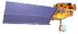



Calibration
Calibration
Raw data
(L0)~L1
Scattering
Atmosphere
Absorption
Transmittance
Surface Reflectance
NDVI/EVI, etc…
L2~L3
Validation
Ground Surface
LAI/FPAR, NPP/GPP, Land Cover Type, LST/SST etc…
L3~L4

Slide 7
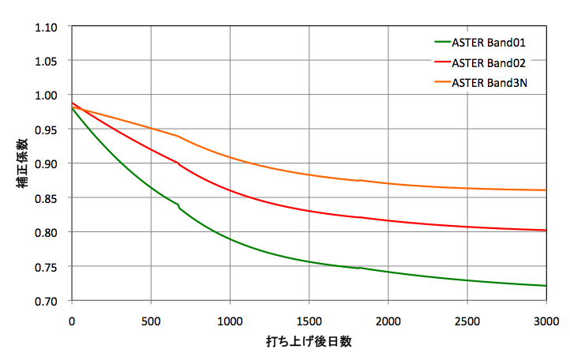
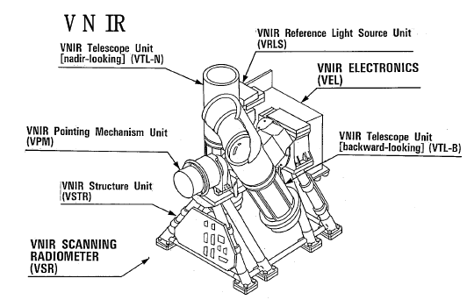
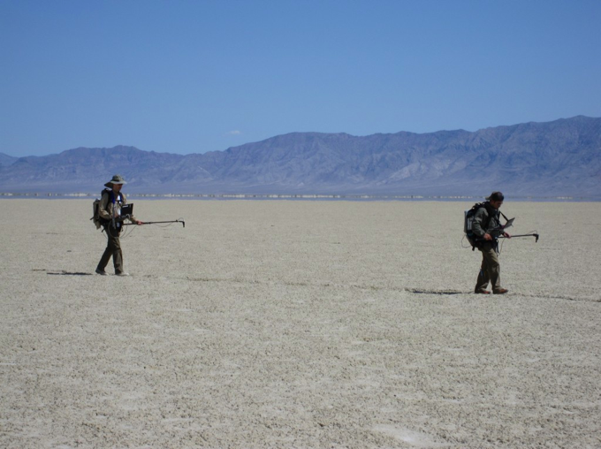
On-board calibration
Degradation
Re-calibration coefficient
On-board calibration
Days since launch
The on-board is designed to guarantee an accurate calibration, and has the potential degradation over time.
Vicarious calibration

Slide 8
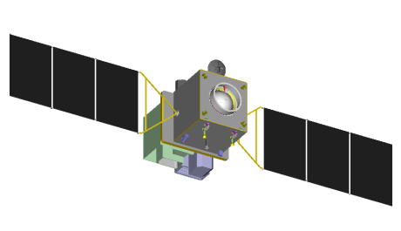

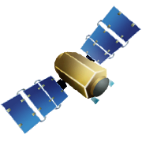
Vicarious calibration and Cross calibration
1. Vicarious Calibration
– Ground measurement over the desert (sand or salt lake) or pseudo-invariant desert sites
– Absolute reflectance or radiance
– Wavelength, atmospheric absorption, sensitivity, etc…
– Radiative transfer models
2. Cross Calibration
– Sensors onboard the same platform
– Well-calibrated sensors
– Other sensors
– TOA radiance or reflectance
Satellite sensor
Satellite sensor
Atmosphere
Ground
Measurements
Other satellite sensors
Surface
Vicarious Calibration
Cross Calibration
Vicarious calibration : satellite-based + ground-based + radiative transfer model
Cross calibration : satellite-based + other satellites based

Slide 9
Validation
Calibration
Raw data
(L0)~L1
Scattering
Atmosphere
Absorption
Transmittance
Surface Reflectance
NDVI/EVI, etc…
L2~L3
Validation
Ground Surface
LAI/FPAR, NPP/GPP, Land Cover Type, LST/SST etc…
L3~L4

Slide 10
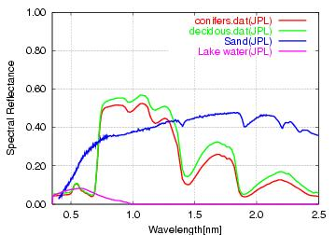
Various surface reflectances

Slide 11
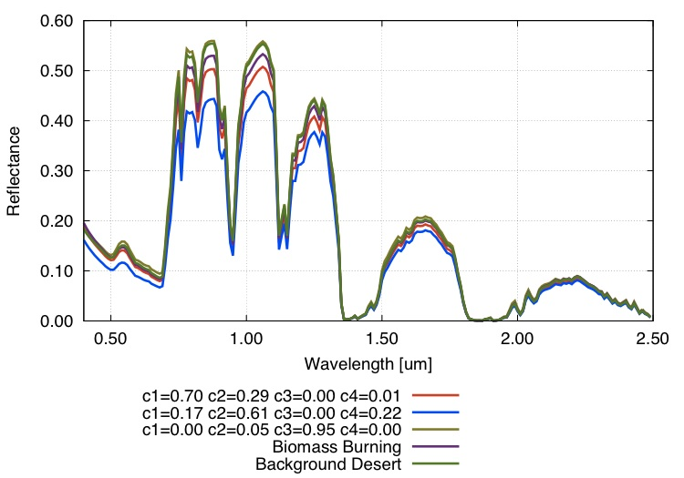
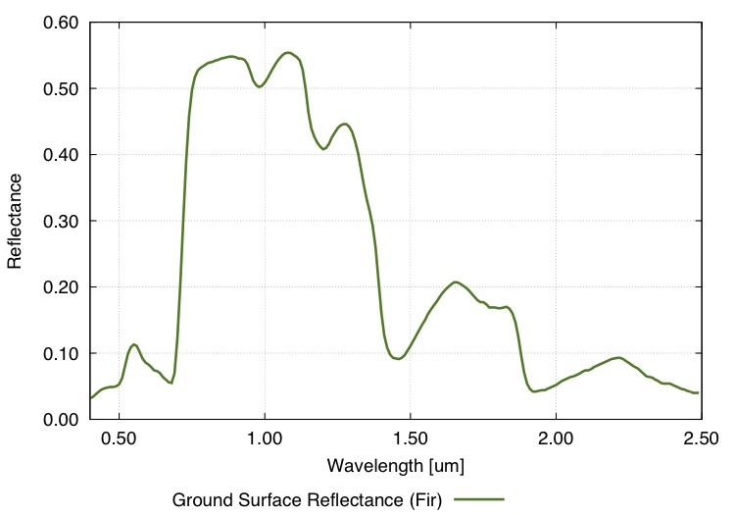
Satellite-based and ground-measured reflectance
O2 absorption
Rayleigh Scattering and O3 absorption
Water vapor absorption
τ=0.50
c(1) = volumic % of dust-like
c(2) = volumic % of water-soluble
c(3) = volumic % of oceanic
c(4) = volumic % of soot
Irradiance : Kurucz (2006)
Solar Zenith Angle : 25.44 [deg]
Relative Azimuth Angle : 0.0 [deg]
Elevation : 0.0 [m]
H2O=0.419g/cm2, O3=480DU
Satellite-measured reflectance
(TOA reflectance)
Ground-measured reflectance
(TOC reflectance, Fir_Tree IH91-2)

Slide 12
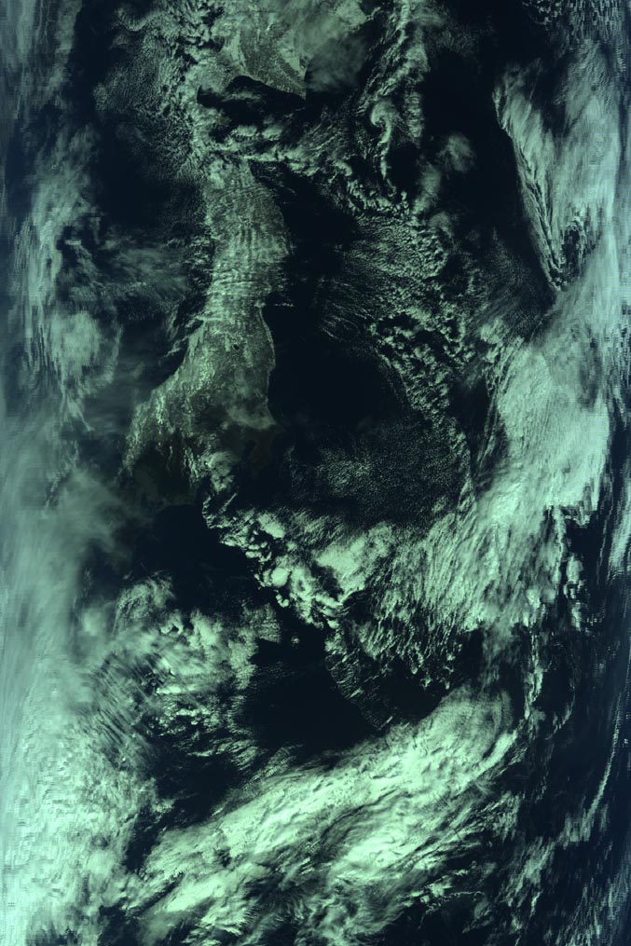
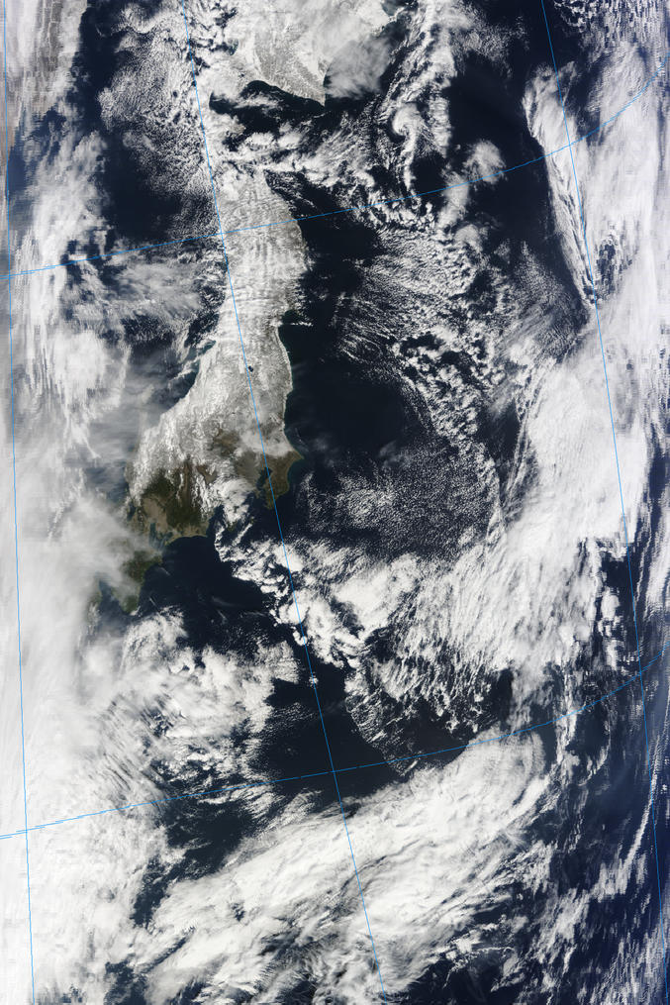
L1
L2
Before atmospheric correction
After atmospheric correction
"The sky is very dark; the earth is bluish,”
--- Russian cosmonaut Yuri Gagarin
Captured by MODIS/Terra on Feb. 14, 2010

Slide 13
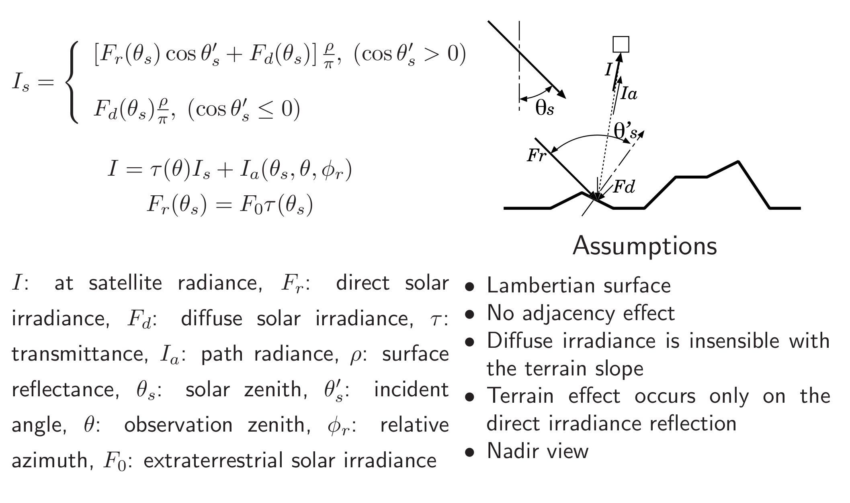
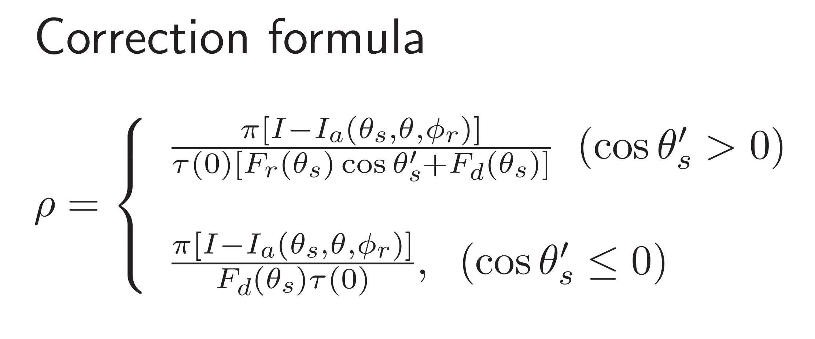
Atmospheric Correction
(Sunny Area)
(Shaded Area)
MODTRAN3.7-based algorithm (Moriyama ,2009)
Notes:
We adopted the MODTRAN3.7-based[14] atmospheric correction algorithms for ASTER VNIR and SWIR bands on our system [15]. This algorithm is originally able to correct Rayleigh scattering, water vapor absorption, and aerosol effects with terrain effects by using ASTER DEM and MODIS Atmosphere L3 gridded product (MOD08_D3) [16]. Atmospheric correction algorithms for VNIR and SWIR bands use the exoatmospheric solar irradiance. The ASTER science team adopts the irradiance model based on World Radiation Center (WRC), however, there are some differences from the other irradiance models, especially in SWIR region. Therefore, we will add the option for selecting the irradiance models on our system. Fig 3 shows the example of comparison between the ground measured reflectance factor at Railroad Valley, Nevada andatmosphericallycorrectedASTERsurface reflectance generated by the GEO Grid system. The recalibration options were used for both of VNIR (vicarious calibration) and SWIR (crosstalk correction).

Slide 14
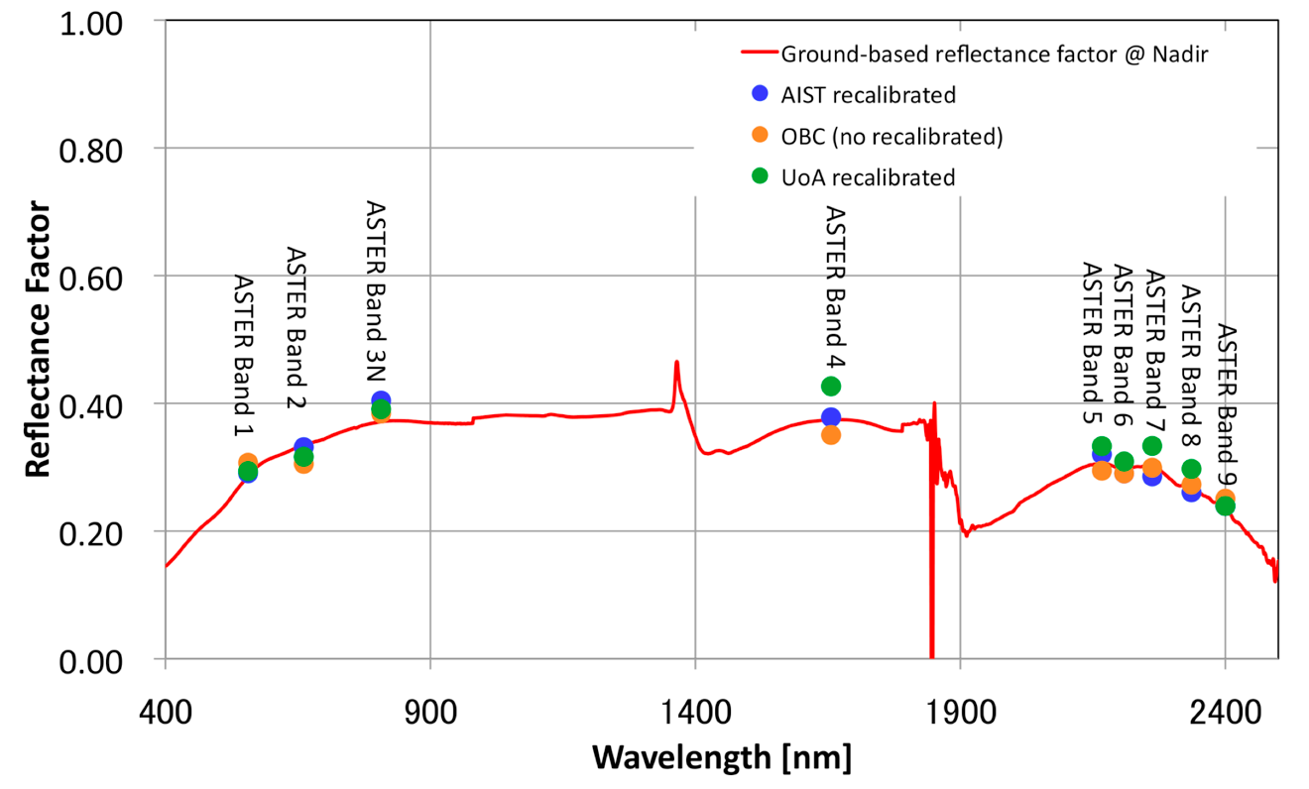
Validation for radiometric and atmospheric corrections
Ground-measured vs. ASTER-measured radiometrically/atmospherically corrected surface reflectance (Dec 15, 2004)

Slide 15
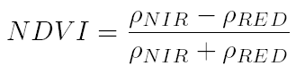
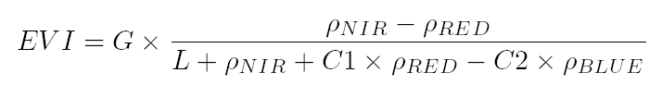
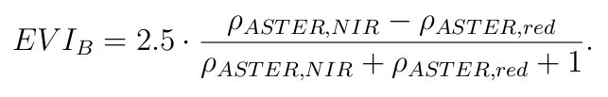
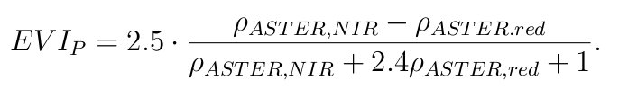
Vegetation indices (VIs)
NDVI (Rose et al.,1974)
Atmospherically corrected reflectances :
ρ_{Blue} , ρ_{Blue}, ρ_{Blue}
EVI (Huete et al., 2002)
MODIS Backup EVI (Didan et al.,2006)
Normalized Difference Vegetation Index (NDVI ):
-> "continuity index"
Enhanced Vegetation Index (EVI):
-> “optimized index”
can reduce …
1. Sensitivity over vegetated area
2. Background soil effects
3. Atmospheric effects
Two-Band EVI (Jiang et al.,2008)

Slide 16
MOD17/MYD17
Composite products (8 days)
GPP/NPP
Derived from VIs (MOD13), LAI/fAPAR (MOD15) and land cover (MOD12) products, etc …
PsnNet_1km
Net Photosynthesis
MODLAND_QC
Quality assessment flag
Clouds …
MOD17 ATBD (S. Running et al., 1999)

Slide 17
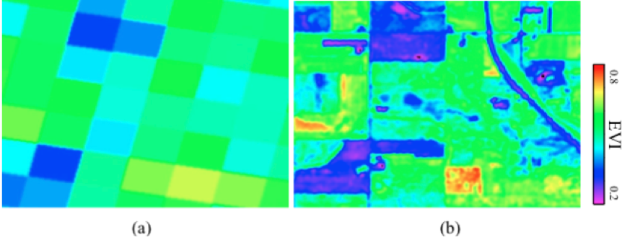
The comparison between MODIS EVI and ASTER EVI_{C} images
MODIS EVI
ASTER EVI_{C}
Rosemount of Minnesota in USA
Finer resolution can discriminate more detailed distributions for the croplands.
Integration among ground-based and finer/coastal resolution satellite-based data are helpful for calibration and validation.

Slide 18


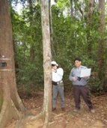
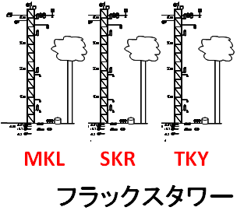
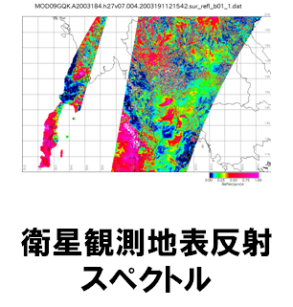
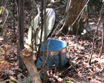
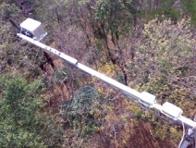
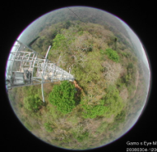
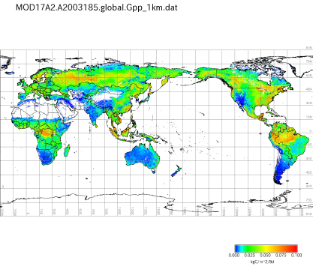
Surface observation (multiple discrete points, many observation items)
Satellite observation (areal distribution)
EMTech
ITRI
TKY
SKR
MKL
….
Surface observation Sensor Network
Automated pre-product data processing
GPP SKR-DEF, 2002-2003
Post-product Processing Data Assimilation
by Computer Grid
+ GIS Standards
Surface Data Product
Training of Satellite Observation Up-scaling of Surface Observation
Distribution Map of Primary Production (Carbon Absorption)
Standardized Data Archive

Slide 19
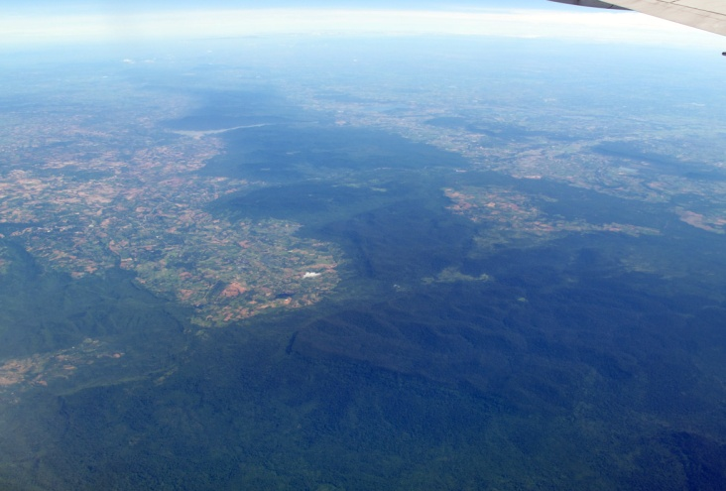
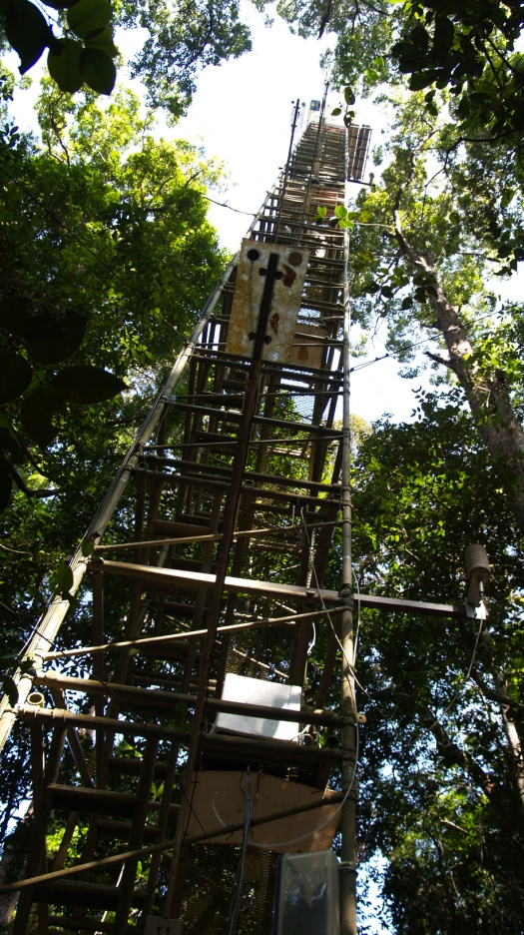
Instrumentation
N
The SKR DEF (flux) tower
40m
38m
30m
20090710_0855ICT
Wind vane
29m
Rain gauge
Air inlet (flux and profile)
20m
Ultrasonic anemometer
21m
Thermohygrometer
VIS/IR radiometer
Pyranometer
Radiation thermometer
10m
10m
PFD sensor (tower)
PFD sensor (floor)
Thermometer (soil)
3m
Soil heat flux sensor
Soil moisture sensor
-0.05
-0.01
Equitensiometer
-0.1
-0.2
Fixed view camera
-0.5
Soil flux chamber

Slide 20
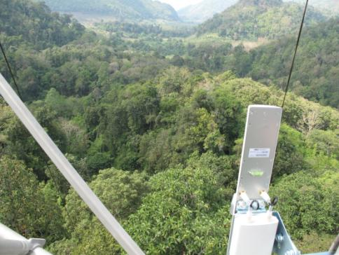

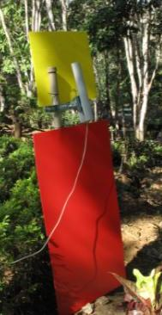
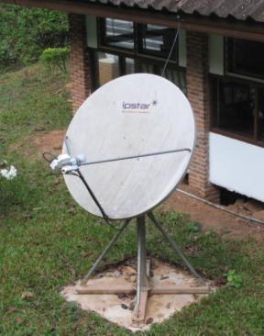
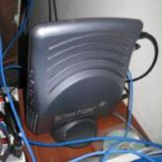
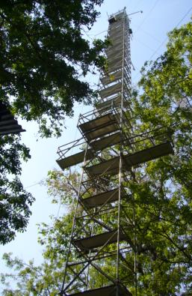
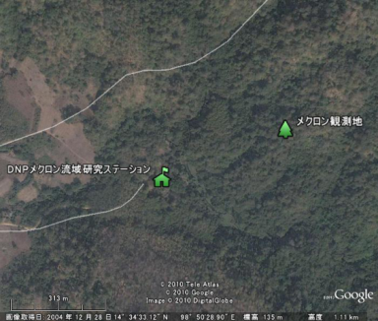
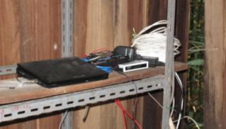
Data acquisition network between MaeKlong station and AIST Tsukuba
400m
Long-range Wireless LAN(PtP)
Satellite internet (IPSTAR)
36000km
400m
Temporary
storage
server
36000km
IPSTAR
Measurement data in the tower
To the long-range wireless LAN
4000km
5km
AIST-EMTech

Slide 21
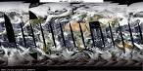


GPP validation tool by using OGC System Framework
Various satellite products
MKL
SKR
TKY
SOS
Surface reflectance
GPP, NDVI, EVI, …
52North SOS
FLUX
GetObservation
(b1,b2,b3,state_1km)
XML
GetObservation
(GPP)
XML
XML
(Nagai et al., submitted to IJRS)
WPS
Execute
[station,startdate,enddate,product,confd,maxday,dout]
PyWPS
Validation process
Least Square Fitting process
JSON
R
rpy2
simplejson
Etc..
Client

Slide 22
Summary
Calibration and validation (Cal/Val) for optical satellite is very important to keep the satellite-derived surface physical properties with high quality.
Ground-measured data are very useful for the Cal/Val of satellite data.
OGC standard protocols (WxS, SOS, …) help to develop the Cal/Val tools.
We, firstly, focus on GPP validation tools by using OGC standards.
In future, various Cal/Val tools for satellite products will be developed.

Slide 23


Thank you for your attention.
National Institute of
Advanced Industrial Science
and Technology
AIST
Global Earth Observation Grid
http://www.geogrid.org
E-mail : kathkath@ni.aist.go.jp

Slide 24
Backup slides

Slide 25
GEO Grid system capability
for satellite data
ASTER complete data online
Handling large (>180TB of ASTER L0) archive for satellite imagery
PALSAR data online
Access to both ERSDAC and AIST archives
On-demand data processing capability
ASTER DEM/Ortho image can be generated, which is applied the latest radiometric DB, and can be applied vicarious calibration results (VNIR/SWIR) and cross-talk correction (SWIR) etc.
PALSAR SLC/MLI generation
Notes:
We have the system of satellite processing, which is called as “GEO Grid”.
Our system can provide the ASTER and PALSAR higher level products.
In this case, we have all ASTER L0 data on HDD, which is more than 180TB currently.
ASTER DEM/Ortho image can be generated, which is applied the latest radiometric DB, and can be applied vicarious calibration results (VNIR/SWIR) and cross-talk correction (SWIR) etc.

Slide 26
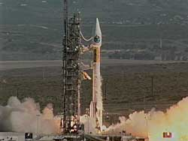
ASTER and MODIS
http://spaceflightnow.com/
Satellite TERRA
MODIS
ASTER
Launched on Dec. 18th, 1999
1. ASTER
(Advanced Spaceborne Thermal Emission and Reflection Radiometer)
2. MODIS
(Moderate-resolution Imaging Spectroradiometer)
3. MISR
(Multi-angle Imaging SpectroRadiometer)
4. CERES
(Clouds and the Earth's Radiant Energy System)
5. MOPITT
(Measurements of Pollution in the Troposphere)
MODIS is the well-calibrated sensor as a reference, which is observed simultaneously by ASTER.
Cross-calibration between ASTER and MODIS is very useful.
Notes:
Terra satellite was launched in Dec of 1999, and has 5 sensors. ASTER and MODIS is two of them, which are the optical sensors measured from VNIR to TIR. Especially, MODIS is known as the well-calibrated sensor, and cross-calibration between ASTER and MODIS is very useful.

Slide 27
CEOS Reference Standard Test Sites
Instruments sites
Pseudo-invariant desert sites
Site Name | Longitude [deg] | Latitude [deg] | ASTER scenes (cloud : 0~100%)
Tuz Golu | E33.33 | N38.83 | 22
Railroad Valley Playa | W115.69 | N38.50 | 123
Negev | E35.01 | N30.11 | 56
La Crau | E4.86 | N43.56 | 49
Ivanpah Playa | W115.40 | N35.57 | 180
Frenchman Flat | W115.93 | N36.81 | 92
Dunhuang | E94.34 | N40.13 | 51
DOME-C | E123.0 | S74.50 | 46
Site Name | Longitude [deg] | Latitude [deg] | ASTER scenes (cloud : 0~100%)
Libya1 | E13.35 | N24.42 | 12
Libya4 | E23.39 | N28.55 | 136
Mauritania1 | W9.30 | N19.40 | 10
Mauritania2 | W8.78 | N20.85 | 13
Algeria3 | E7.66 | N30.32 | 32
Algeria5 | E2.23 | N31.02 | 0
Apr., 2000 ~ Jul., 2011
Apr., 2000 ~ Jul., 2011
“The CEOS IVOS sub-group members worked with partners around the world to establish a set of CEOS endorsed globally-distributed reference standard test sites for the post-launch calibration of space-based optical imaging sensors. Based on the decision from the CEOS IVOS-19 meeting that was help in Phoenix, AZ, at present there are eight instrumented sites and five pseudo-invariant test sites.”
http://calval.cr.usgs.gov/sites_catalog_ceos_sites.php
Notes:
CEOS reference standard test sites are for instruments and pseudo-invariant desert sites.
Especially, the instruments sites are called as “LANDNET” sites, and these sites are recommended for vicarious calibration.
CEOS IVOS subgroup recommends these standard sites for vicarious calibration and cross-calibration.

Slide 28
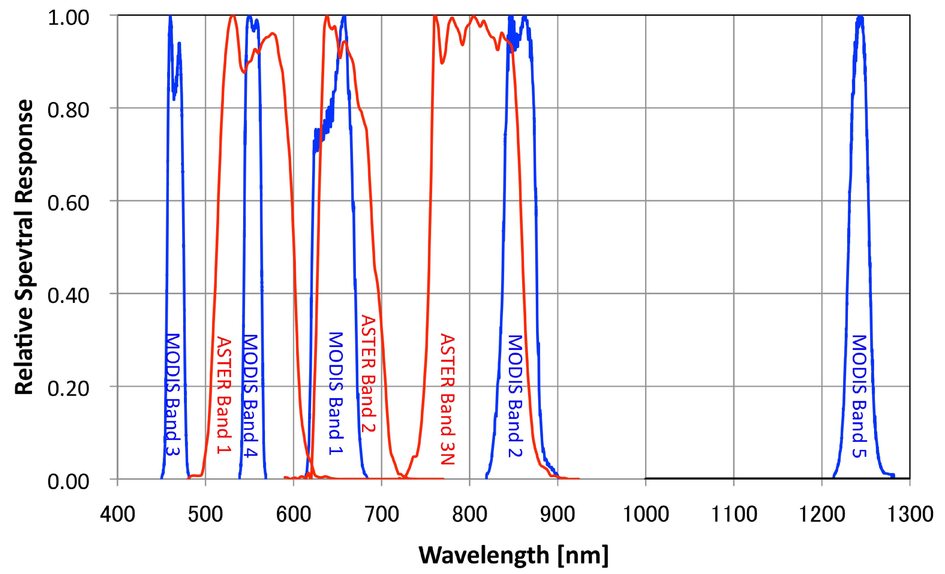
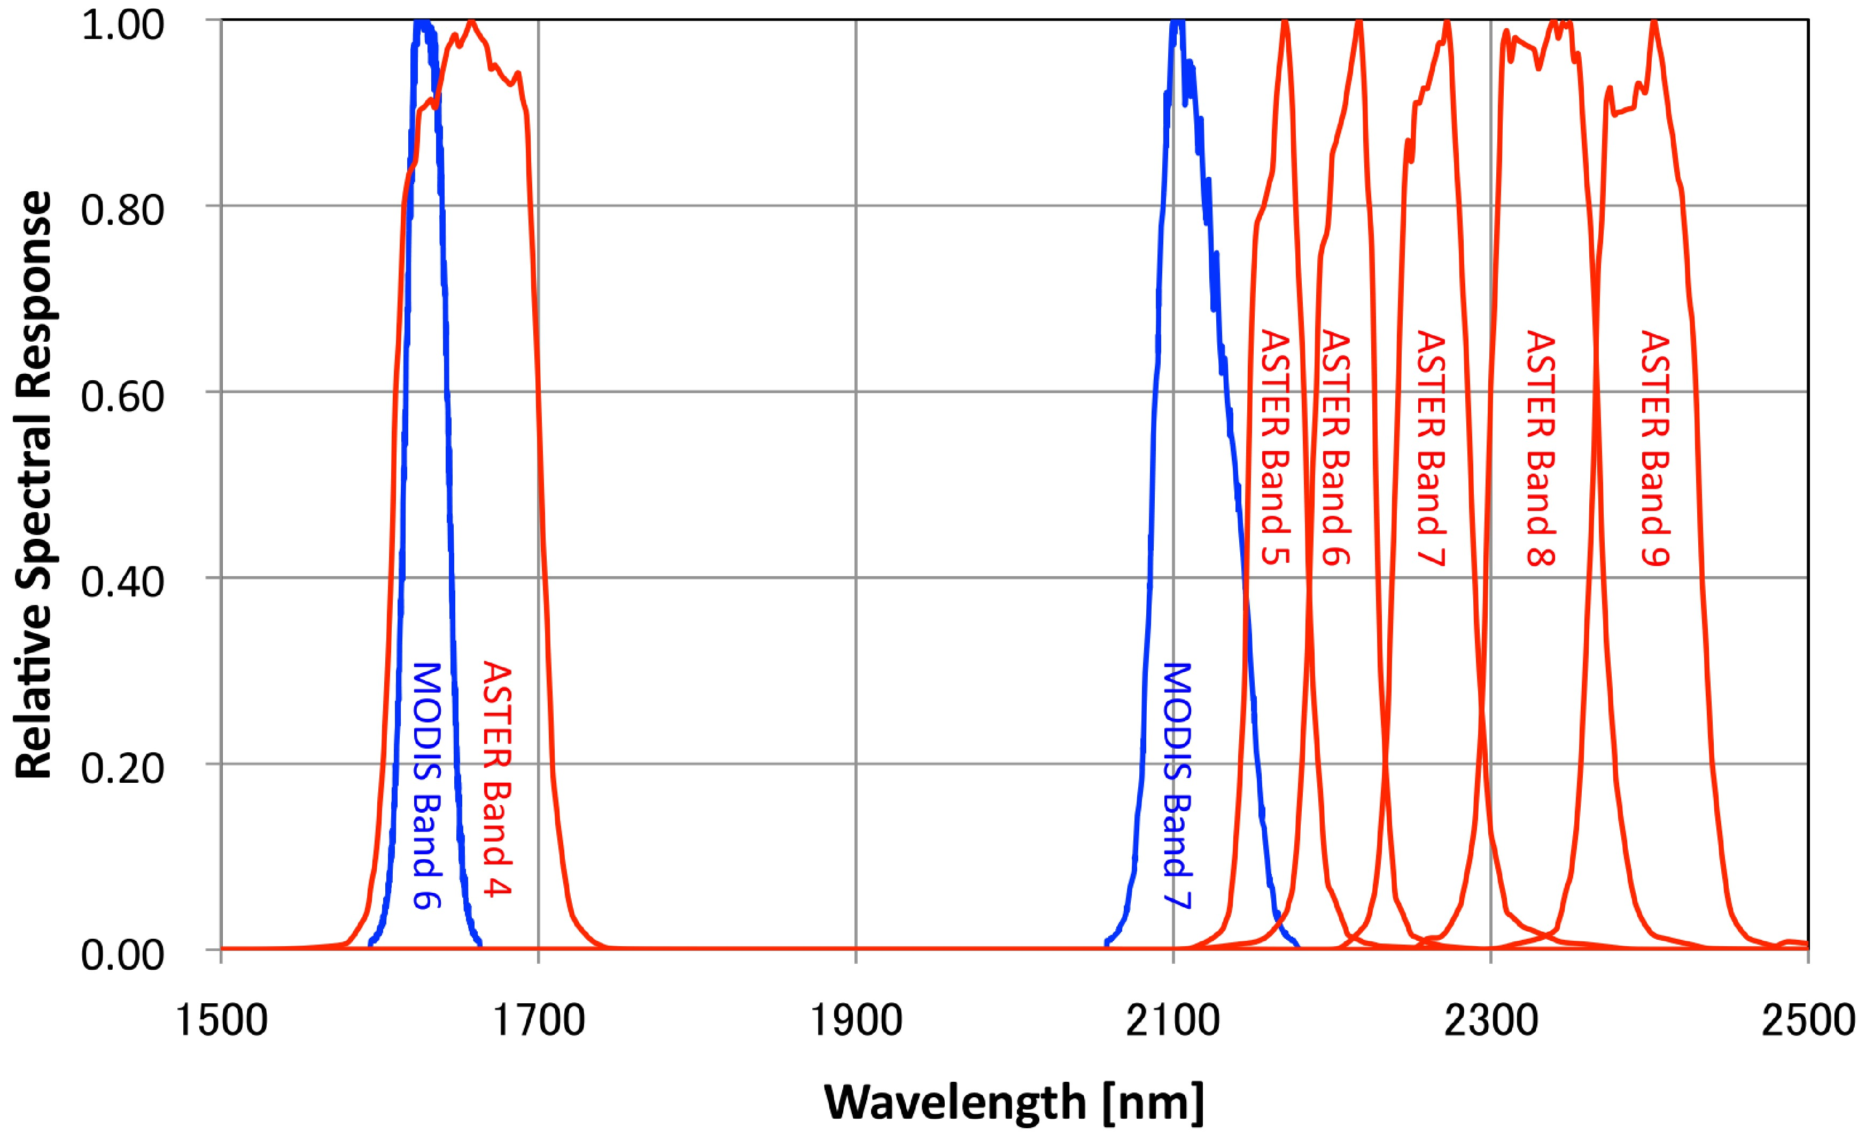
ASTER and MODIS Relative Spectral Response
VNIR
SWIR
Relative Spectral Response Function of ASTER and MODIS
• ASTER Band 1 vs. MODIS Band 4 (Green)
• ASTER Band 2 vs. MODIS Band 1 (Red)
• ASTER Band 3N vs. MODIS Band 2 (NIR)
• ASTER Band 4 vs. MODIS Band 6 (SWIR)
Notes:
This figure shows the comparison between ASTER and MODIS relative spectral responses. As you can see, we can compare green, red, NIR, and SWIR bands.

Slide 29
Validation for ASTER Geolocation
Image matching using orthorectified images (~256 x 256 pixels)
σ_{x} is 1.2 pixels (~18 m)
σ_{y} is 0.7 pixels (~11 m)
Y
X
Overlap region
ASTER Footprints
Kodama et al., IGARSS2010
Notes:
Our ASTER products were evaluated the geolocation accuracy, and the results indicated very good accuracy for geometric, and the error of x direction is1.2 pixels, y direction is .7 pixels.

Slide 30
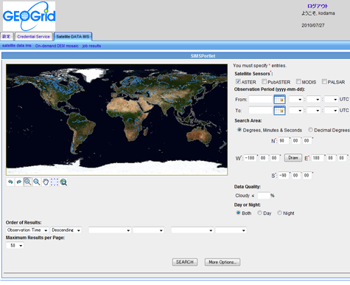
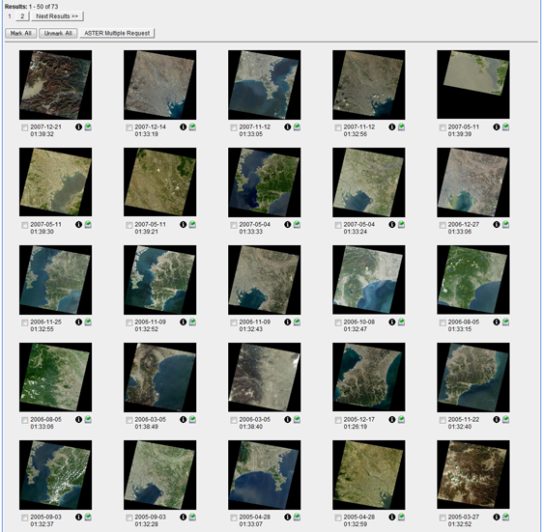
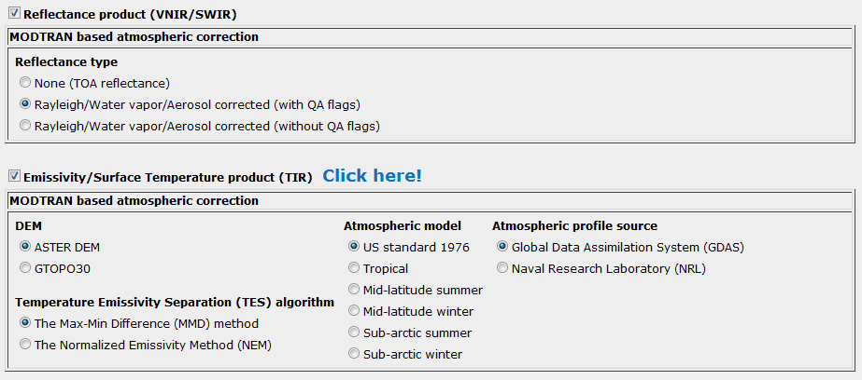
GEO Grid portal

Slide 31
Validation for radiometric and atmospheric corrections
ASTER L1A/L3A (VN/SW/TIR)
Calibration result
Onboard
calibration
(VN/SW IR)
UoA
recalibration
(VN/SW IR)
AIST
recalibration
(VN/SWIR)
Radiometric recalibration (TIR)
Atmospheric
Correction in TIR
Crosstalk correction in SWIR
Atmospheric Correction in VN/SWIR
(Raleigh/Water vapor/Aerosol)
MOD08_D3
ASTER Atmospherically Corrected Surface Reflectance in VN/SWIR
Emissivity/Surface
Temperature in TIR
Higher level product
Notes:
This figure shows the schematic flow of our system. We provided 3 kinds of radiance products, which are OBC (not recalibrated),

Slide 32
Atmospheric Correction (Cont’d.)
(Sunny Area)
(Shaded Area)
Atmospheric data sources: MODIS (MOD08_D3): 1[deg.] grid
Aerosol optical thickness (AOT)@0.55[μm]: Corrected_Optical_Depth_Land_QA_Mean
Atmospheric profile: Water_Vapor_Near_Infrared_Clear_QA_Mean
Retrieved_Temperature_Profile_Mean

Slide 33
L1 -> L2 -> Higher Level
Radiometric gain, offset, SZA, VZA, RAA, d²
On-board calibration
Radiometric re-calibration
Solar Irradiance
AOT, Water Vapor, etc.
DEM
Atmospheric and topographic correction
Atmospherically corrected surface reflectance
Higher level products

Slide 34
Validation Process Work Flow
Request SOS
Current date < End date
and Current date not in Excluding date list
True
Calculating NDVI, EVI
Find Max NDVI in day range (default : 15 days)
False
NDVI >= Max NDVI x % Accepted
( default : 80%)
and Min EVI >= EVI <= Max EVI
False
True
Export as JSON
Prepare Chart object

Slide 35
背景
衛星光学センサのプロダクト
地表面反射率プロダクト(L2)は陸域高次レベルのプロダクト (LAI, fAPAR, GPP等)の基本であり、重要
大気補正アルゴリズムでは衛星大気プロダクトや地上計測値を用いる
大気プロダクト(水蒸気、エアロソル等)は地球の放射収支を知る上で重要
衛星プロダクトと地上観測値との比較
画素毎に品質フラグはあるが当てにならないので、しばしば地上観測値(天空画像や直下画像等を含め)との比較を行う(QA)
衛星プロダクトを地上観測値に合わせたり、様々な衛星プロダクトの組み合わせで算出される物理量を地上観測値と比較する(検証)
上記が簡単にプレビュー出来るようなものがあると便利
おまけに地上観測データの位置・日時から衛星データの検索やプロダクト創出が簡単にできると便利

Slide 36
ツールを作るにあたって
衛星データ(エリア)と現地観測データ(点)は、位置・日時・処理レベル等メタデータが付随する
統合するにあたってはGISの仕組みを使う
汎用性を持たせるためにも、GIS標準を用いた方がよい
データの設計、品質、記述方法、仕様の書き方等について共通のルールを持たせたもの
ISO/TC211
OGC（Open Geospatial Consortium）

Slide 37
OGC標準規格
OGCとは？
OGC は、空間データの世界標準・相互運用を目指した 非営利団体で、仕様策定、実証実験、適合試験等を実施
GIS 関連企業の他に、IT 産業、大学、研究 機関等の団体(300以上)が加盟
何が得か？
異なるGISソフト間での相互利用の拡大が期待される。
衛星データも現地観測データも標準化された形であれば、OGC準拠のソフトウェアで即座な読み込みや表示が可能

